Slide 1
Bank Loan Case Study

Slide 2
Project description:
In this project, the objective is to use Exploratory Data Analysis (EDA) to analyze patterns in a dataset containing loan applications and understand how customer and loan attributes influence the likelihood of loan default. The project is set in the context of a finance company specializing in lending loans to urban customers. The company is facing challenges with defaulting customers who lack sufficient credit history, leading to both missed business opportunities and financial losses. The ultimate goal is to identify key factors that indicate if a customer will have difficulty repaying their loan installments, which can be used to make informed decisions about loan approvals.
Approach:
The project will be executed in several stages, leveraging Microsoft Excel for data analysis:
Data Preparation:
Download the provided dataset containing loan application information.
The case study has two datasets to analyses “application_data.csv” and “previous_application.csv”. And “columns_description.csv” has all the descriptions of the above dataset. Therefore, to proceed with the case study the above-mentioned data are analyzed.
Load the dataset into Excel and inspect its structure and variables.

Slide 3
2. Identifying Missing Data:
Utilize Excel functions such as COUNTIF, COUNTBLANK to identify missing data in the dataset.
Determine an appropriate method for dealing with missing data, which could include imputation using function MEDIAN . As MEDIAN is not case sensitive.
3. Identifying Outliers:
Using Box & Whisker graph the outliers can identify.
4. Analyzing Data Imbalance:
Utilizing Pivort table and barchart the data imbalance can identify.
5. Univariate, Segmented Univariate, and Bivariate Analysis:
Utilizing Pivort table,treemap and barchart Univariate, Segmented Univariate, and Bivariate Analysis can be done.
6. Identifying Top Correlations:
Tech-Stack Used:
For this project, Microsoft Excel (version 2019) will be utilized as the primary tool for data analysis. Excel's built-in functions, features, and tools such as pivot tables, charts, statistical functions, and conditional formatting will be leveraged to perform the required tasks.

Slide 4
Insights:
Throughout the analysis, insights into the key factors influencing loan default are expected to be uncovered. By identifying missing data, outliers, and correlations between variables and the target variable, the project aims to provide actionable insights for the finance company. These insights will aid in making informed decisions about loan approvals, risk mitigation strategies, and potential adjustments to loan terms for different customer segments.
Task 1: Identify Missing Data and Deal with it Appropriately
I downloaded the files which were provided by trainity. The files have lots of blanck cell . So firstly I counted the total no of rows , then also counted no of blanck having the row and took ther percentage. The columns which got more than 30% of blank rows , I have deleted those columns and the left columns for text file I filtered the blank cells to remove it and for numeric column I took median and impute the median value in the blanck cells of the colums. I took median over mean because median is not case sensitive to the outliers and can not squid with the outlairs. And like this I got the final dataset.

Slide 5
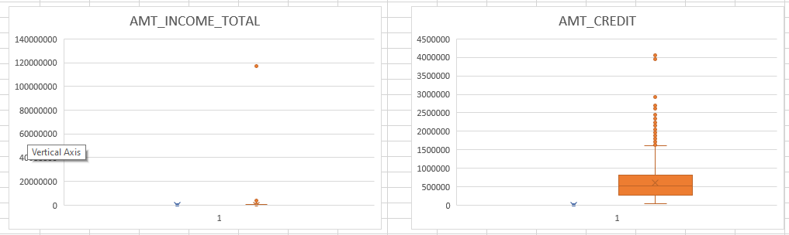
Task 2: Identify Outliers in the Dataset
Outliers: Outliers are data points that deviate significantly from the rest of the data in a dataset. They are observations that lie far away from the bulk of the data points, and they can have a substantial impact on statistical analysis, data modeling, and the overall interpretation of the data.
For application_data.csv file: Used box plotted graph all are done with respect to target.

Slide 6
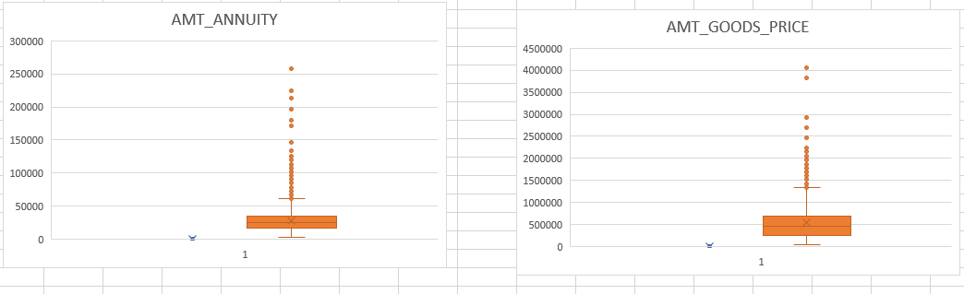
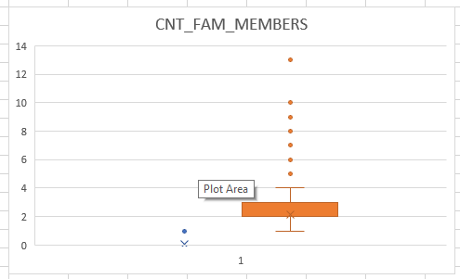

Slide 7
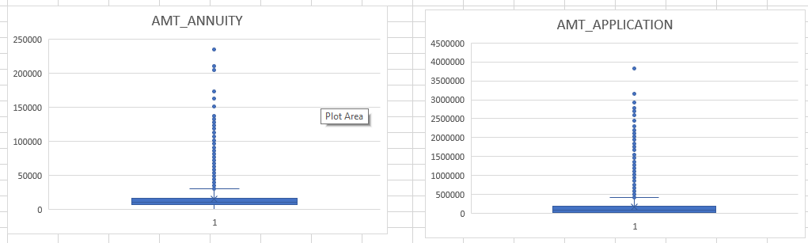
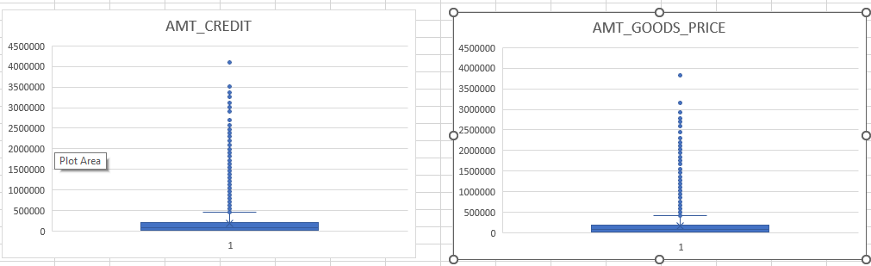
b. For application_data.csv file: Used box plotted graph .

Slide 8
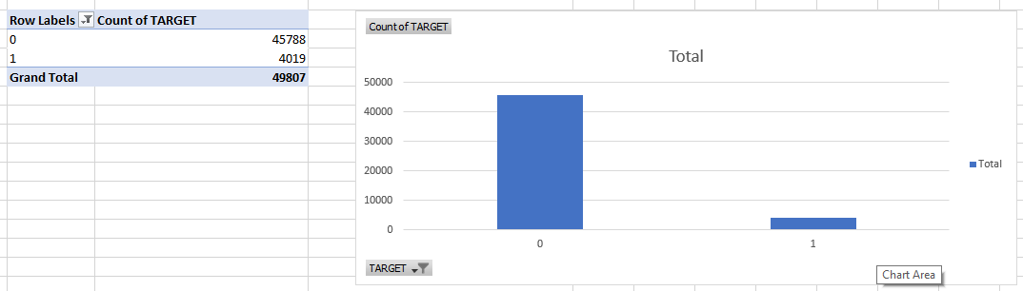
Task 3: Analyze Data Imbalance
Data Imbalance: Data imbalance refers to a situation in a dataset where the distribution of different classes or categories is not proportional. In other words, one class has significantly more or fewer instances compared to the other classes in the dataset. This imbalance can occur in various types of data, such as classification tasks, where the goal is to assign instances to different predefined classes or categories.
a. application_data.csv:

Slide 9
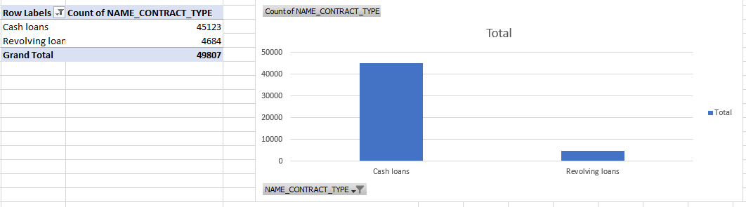
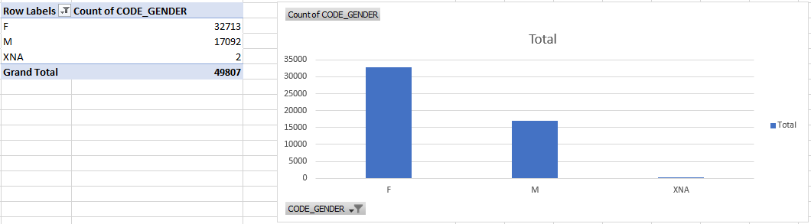

Slide 10
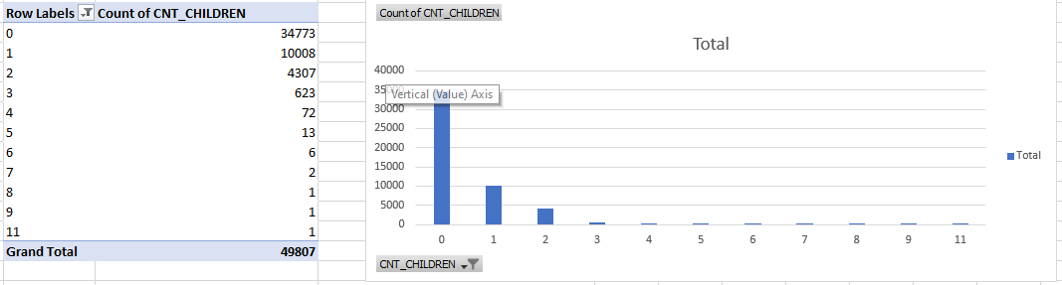
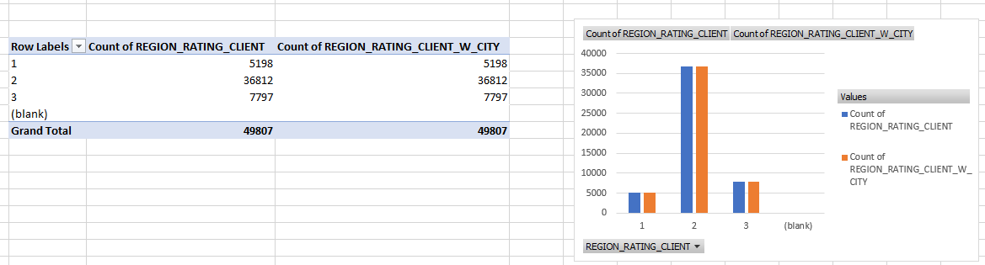

Slide 11
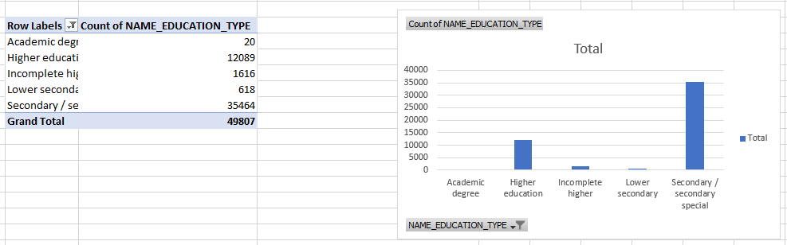
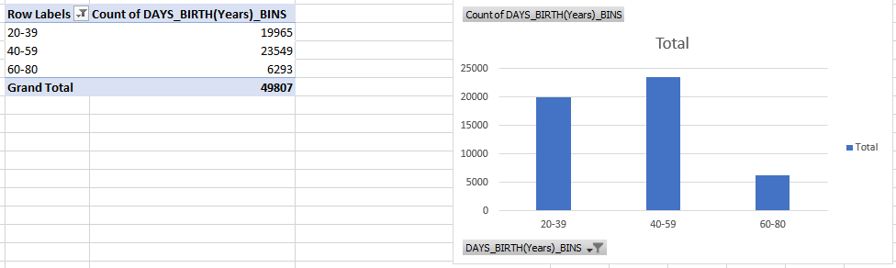

Slide 12
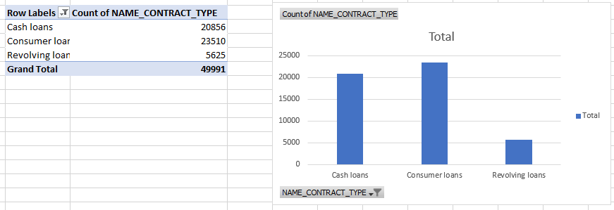
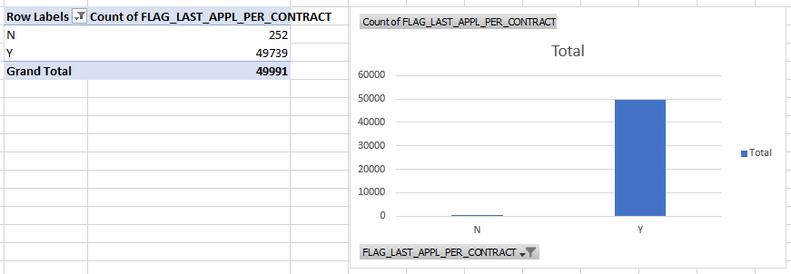
b. previous_application.csv:

Slide 13
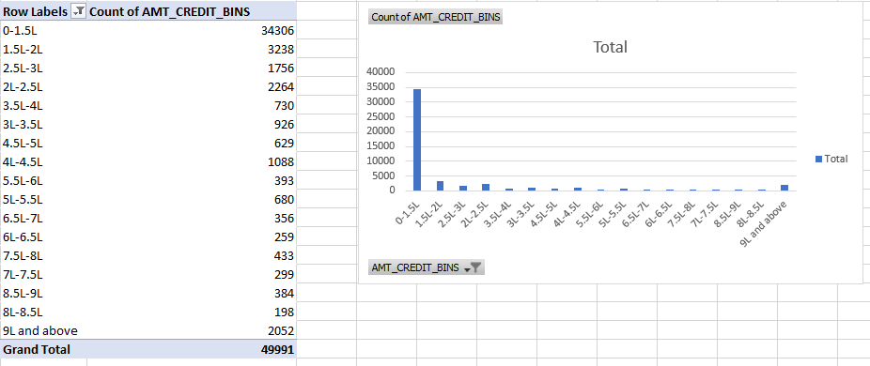
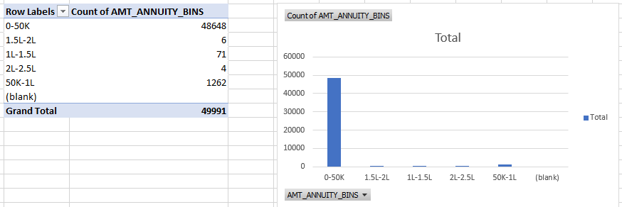

Slide 14
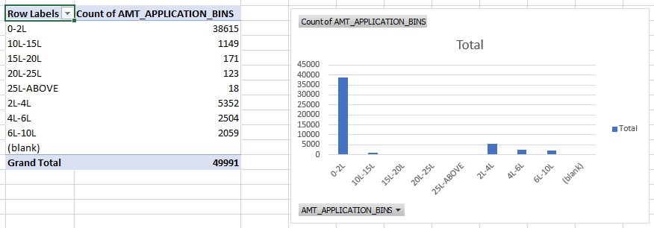
Task 4: Perform Univariate, Segmented Univariate, and Bivariate Analysis
Univariate Analysis: It is the most basic form of statistical data analysis technique. When the data contains only one variable and doesn’t deal with a cause or effect relationships then a Univariate analysis technique is used.

Slide 15
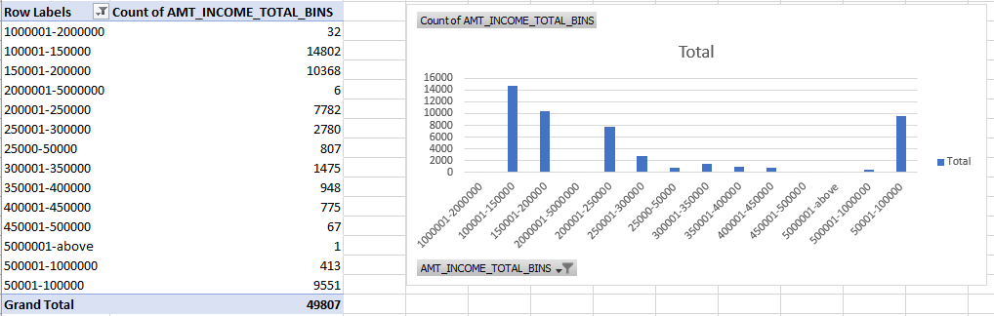
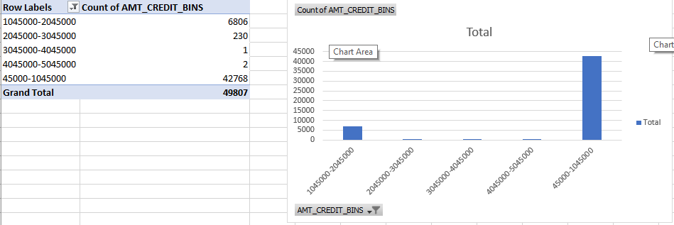
a. application_data.csv:

Slide 16
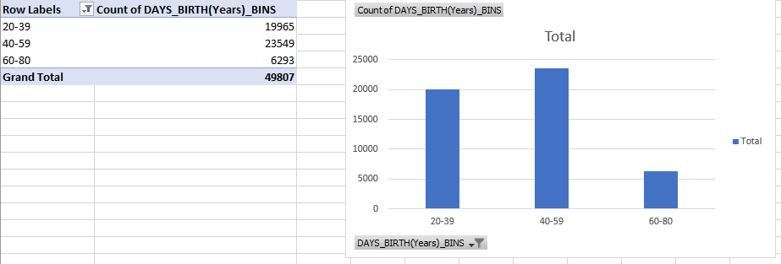
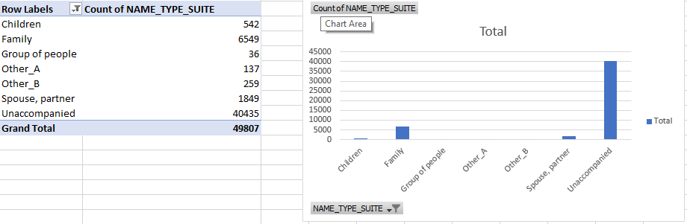

Slide 17
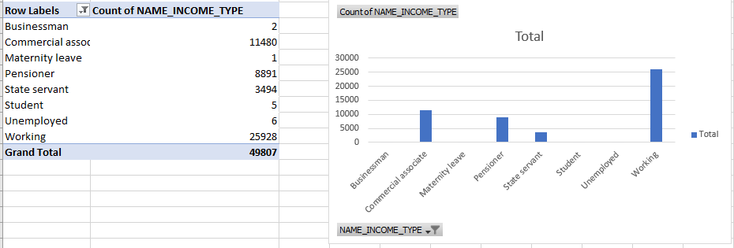
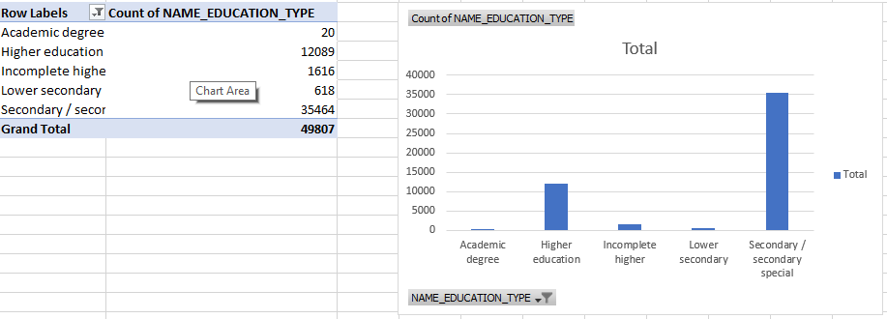

Slide 18
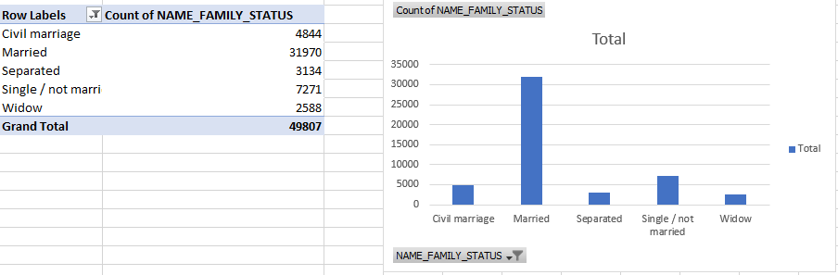
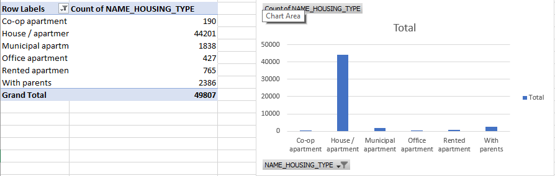

Slide 19
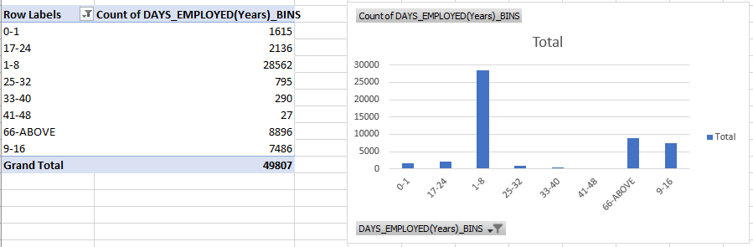
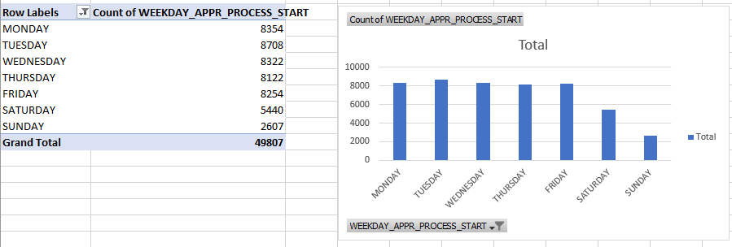

Slide 20
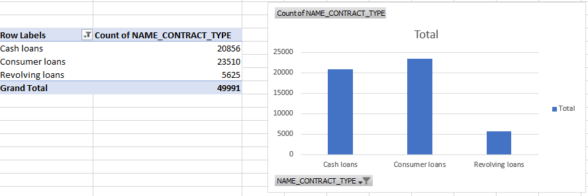
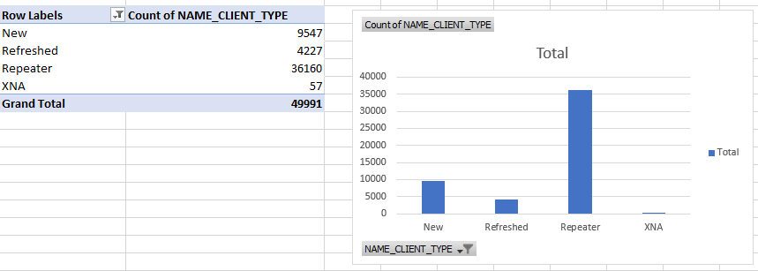
b. previous_application.csv:

Slide 21
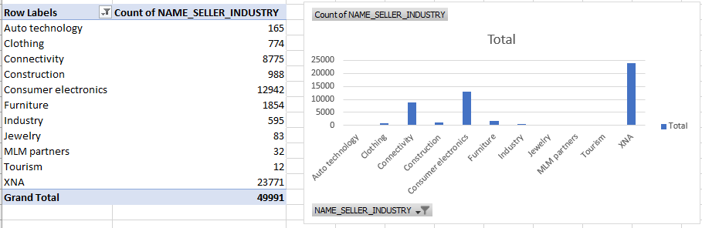
Segmented Univariate Analysis: Segmented univariate analysis" refers to a type of data analysis in which a dataset is divided into segments or subsets, and then a univariate analysis is performed separately on each segment. Univariate analysis focuses on analyzing the distribution, summary statistics, and characteristics of a single variable (feature) at a time. Segmentation involves splitting the data into groups based on some criteria or factors.
a. Application_data.csv: Used treemap

Slide 22
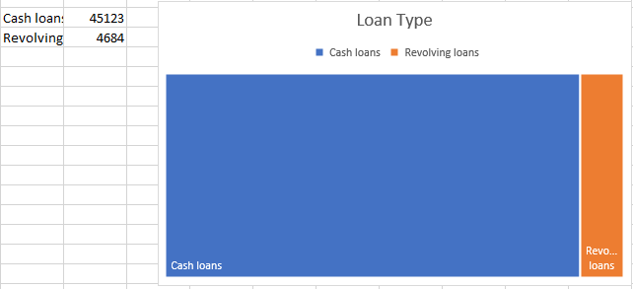
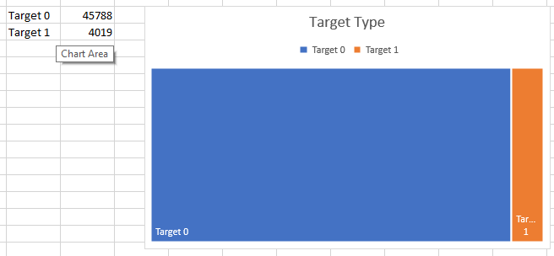

Slide 23
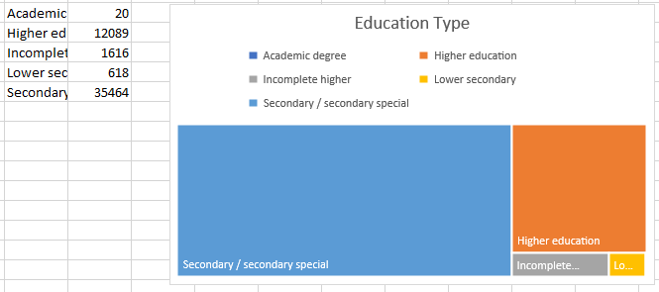
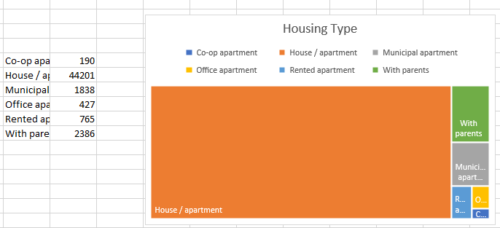

Slide 24
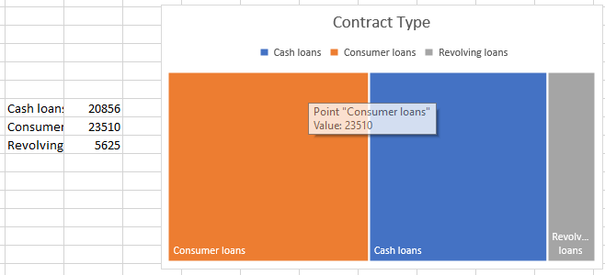
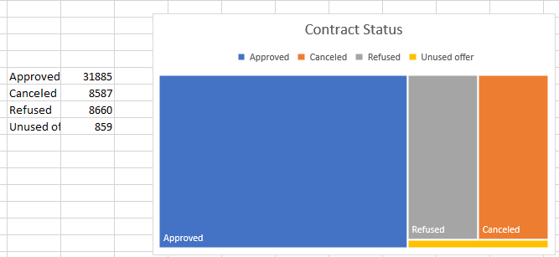
b. Previous_Application.csv: Used treemap

Slide 25
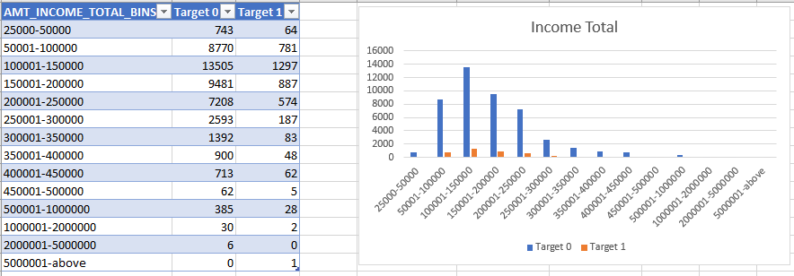
Bivariate Analysis: Bivariate analysis is a type of statistical analysis that involves the examination of the relationship between two variables in a dataset. Unlike univariate analysis, which focuses on analyzing a single variable at a time, bivariate analysis involves studying how two variables are related, interact, or vary together.
For application_data.csv:

Slide 26
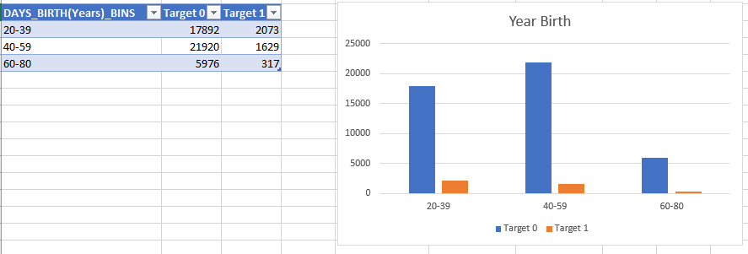
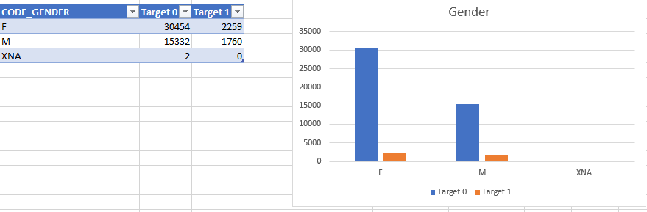

Slide 27
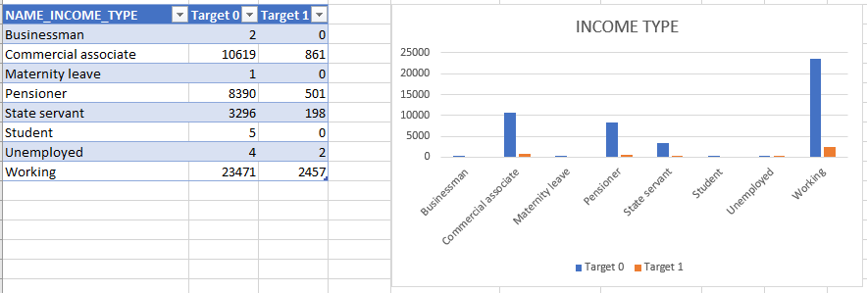
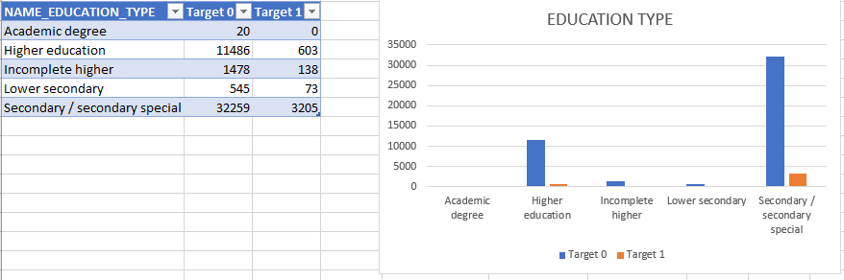

Slide 28
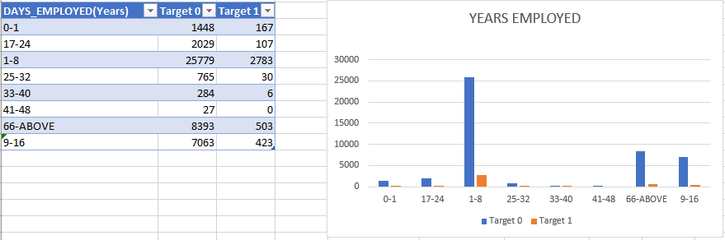
Task 1: Identify Top Correlations for Different Scenarios
Correlation: Correlation is a statistical measure that quantifies the strength and direction of the relationship between two variables. In other words, it assesses how changes in one variable are associated with changes in another variable. Correlation does not imply causation; it simply indicates that there is a relationship between the variables.

Slide 29
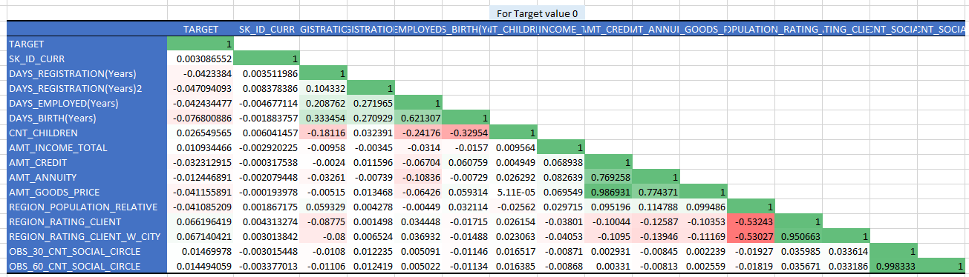
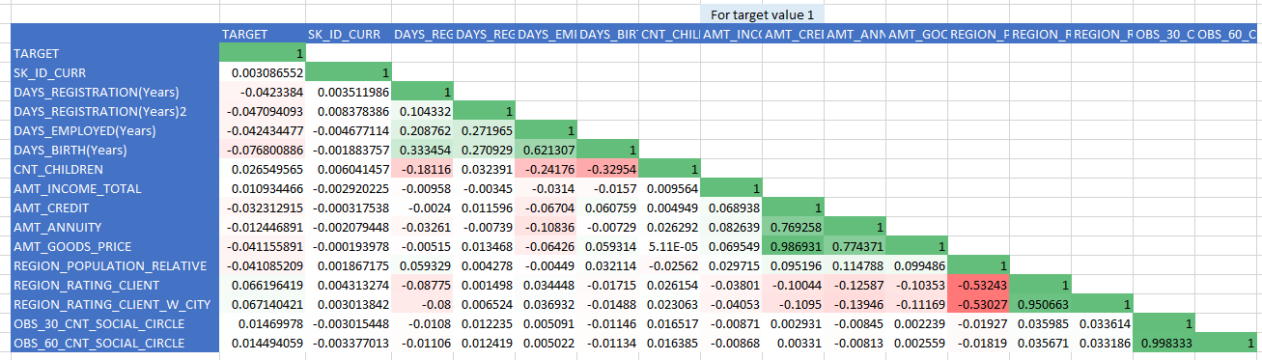
a. application_data.csv:

Slide 30
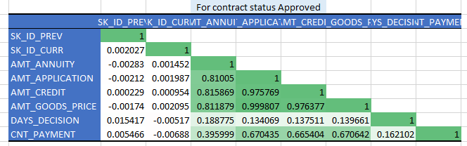
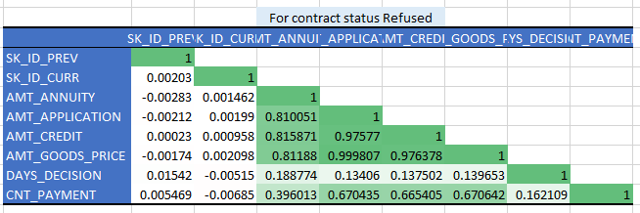
b. previous_application.csv:

Slide 31
RESULT :
The project's successful completion will offer a comprehensive understanding of the factors that contribute to loan default. By performing thorough data analysis using Excel's advanced techniques, statistical analysis, and visualization capabilities, the project aims to provide valuable insights and recommendations to the finance company. These insights will enable the company to make informed decisions to minimize default risk while ensuring capable applicants are not rejected unfairly. The project's findings will contribute to improving loan approval processes and strategies.
File Link 1
File link 2

